Slide 1
DDSAnalytics “Why Did You Quit?”
By
Team Variance
https://github.com/bdelahoussaye/CaseStudy2

Slide 2
Title: Why Did You Quit?
Team Variance Members:
Terry Johnson
Steven Cocke
Brandon de la Houssaye

Slide 3
Presentation Outline
Business Objectives
Data Sourced
Methodology
Evaluation/Results
Summary

Slide 4
Business Objectives
Team Variance was engaged by DDSAnalytics (“Client”) to perform an exploratory data analysis (“EDA”) in order to begin developing models that predict employee turnover.
Client provided Team Variance with certain employee data in order to conclude on the following:
Top three factors that contribute to turnover
Learnings about any job role specific trends
Meaningful trends (TBD) provided from the sourced data
Final deliverables include presentation (this file) as well as supporting analysis/documentation (via github repo)
Outside of scope: predictive models (this engagement merely provides insight on trends). Such models would be covered under future engagements

Slide 5
Data Source
Source Data File: “CaseStudy2-data.csv”
Source data file provided by DDSAnalytics and is based on available employee data
Source Data File Summary:
Classes ‘tbl_df’, ‘tbl’ and 'data.frame': 1470 obs. of 35 variables
[summary statistics are provided in the appendix]

Slide 6
Methodology
The workflow was performed as follows:
Structure the raw data*
Imported raw data into R Studio
Renamed columns to usable text
Formatted column (variables) to proper data types as needed
Perform preliminary analysis the structured data
Remove observations for employees under 18 years of age*
Observed descriptive statistics for seven variables including the observable distribution for two of the seven.
Observed frequency results for Gender, Education, and Occupation as well as the counts of management positions.
Perform deeper analysis based on results of preliminary analysis
Considered relationships between Age and Income; Satisfaction metrics and attrition (Environment, Job, and Relationship)
Identified the top three factors that contribute to attrition
Considered the relationship between job type and job satisfaction metrics
*The document does not cover these steps. For reference, please see relevant github repo.

Slide 7
Evaluation/Results
Prelim Analysis
Pulled the descriptive statistics for Monthly Income, Age, Education, Years in Current Role, Distance from Home, Job Level, and Percentage Salary Hike (in order)
(Monthly Income)
Min. 1st Qu. Median Mean 3rd Qu. Max.
1009 2911 4919 6503 8379 19999
(Age)
Min. 1st Qu. Median Mean 3rd Qu. Max.
18.00 30.00 36.00 36.92 43.00 60.00
(Education)
Min. 1st Qu. Median Mean 3rd Qu. Max.
1.000 2.000 3.000 2.913 4.000 5.000
(Years in Current Role)
Min. 1st Qu. Median Mean 3rd Qu. Max.
0.000 2.000 3.000 4.229 7.000 18.000
(Distance from Home)
Min. 1st Qu. Median Mean 3rd Qu. Max.
1.000 2.000 7.000 9.193 14.000 29.000
(Job Level)
Min. 1st Qu. Median Mean 3rd Qu. Max.
1.000 1.000 2.000 2.064 3.000 5.000
(Percentage Salary Hike)
Min. 1st Qu. Median Mean 3rd Qu. Max.
11.00 12.00 14.00 15.21 18.00 25.00

Slide 8
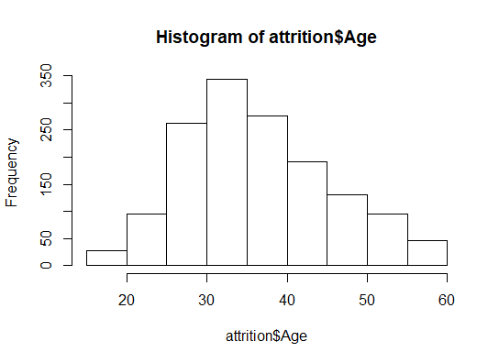
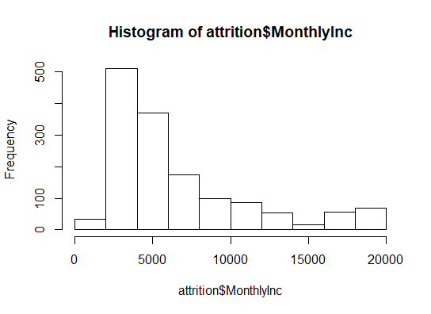
Evaluation/Results
Prelim Analysis
b. Observed Histograms from two of these variables

Slide 9
Evaluation/Results
Prelim Analysis
c. Observed frequencies for Gender, Education, Job Roles, and Management
What does the preliminary analysis tell us?
Pyramid structure (less than 20% are management) and the pay skews left (also observe the difference between mean and median in Monthly Income)
Education: 50% of the workforce has a bachelor or better. The workforce is overly dependent on higher levels of education.
Pay increases: the difference between mean and median tell us that pay increases are not discerning to high performers, or, at the very least, an overwhelming majority of the workforce are deemed neither poor or exceeding.
Activity: Job titles indicate significant amounts of product and R&D. This plus the distance from the office could be indicators of job mobility.

Slide 10
Evaluation/Results
Deeper Analysis
c. First, Determine Top Variables Related to Attrition

Slide 11
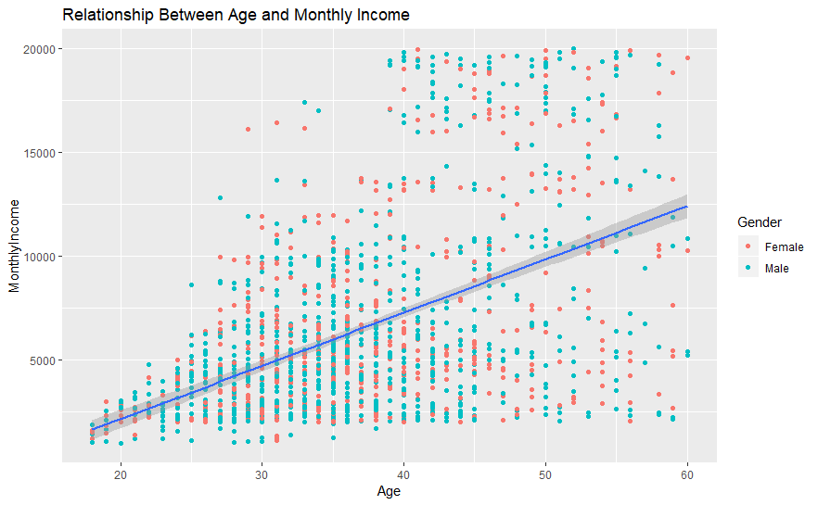
Relationship between Age and Monthly Income by Gender

Slide 12
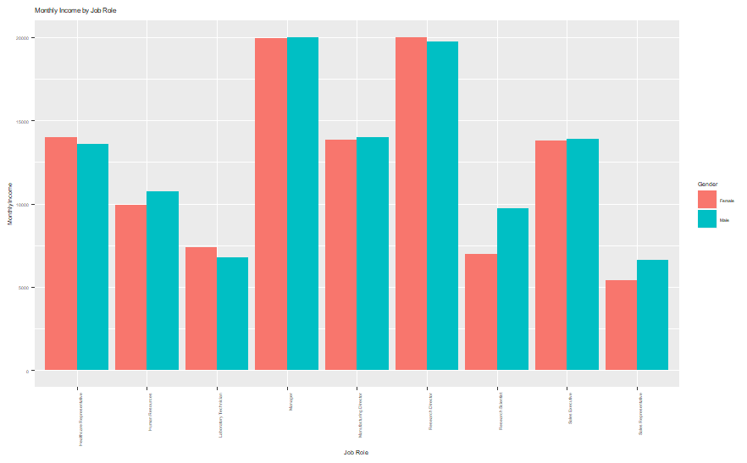
Relationship of Job Title to Monthly Pay by Gender

Slide 13
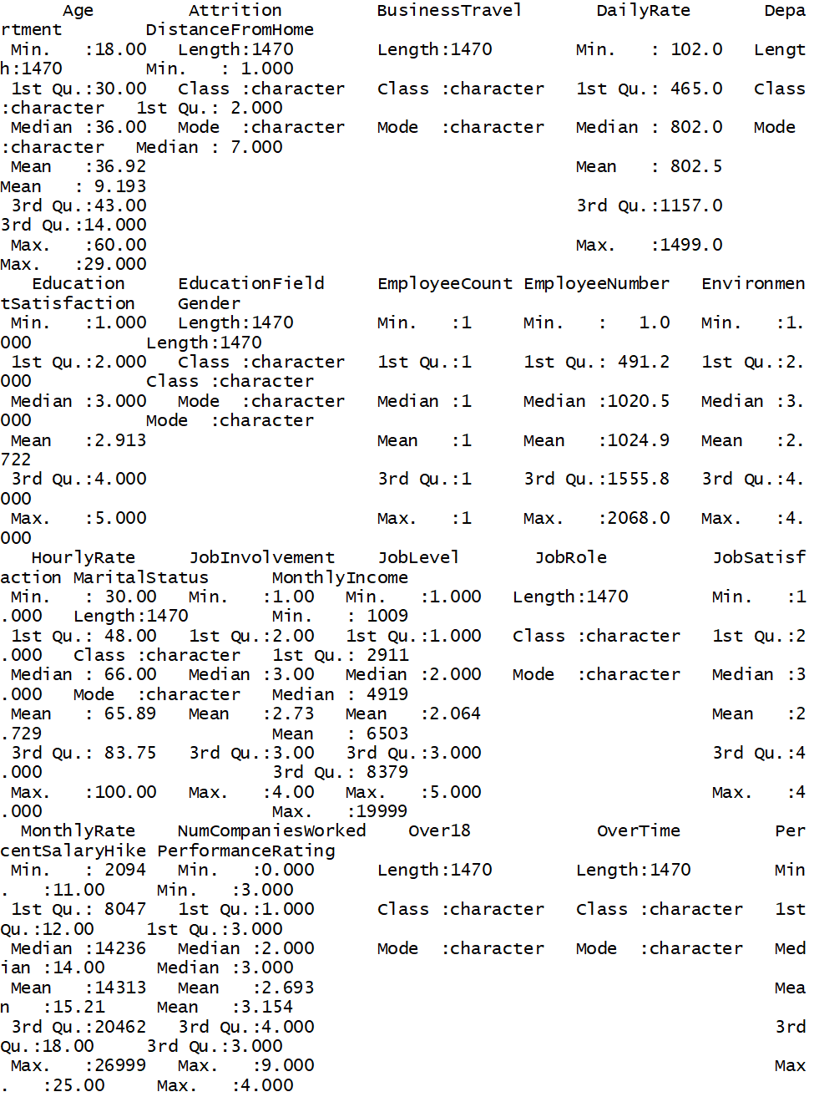
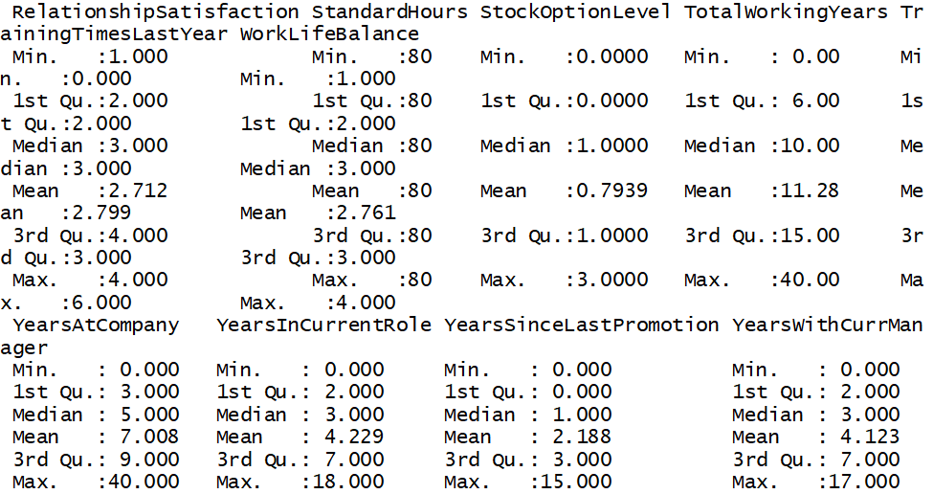
Appendix: Data Source - Summary Statistics

